Slide 1

Multiple Face Recognition
For
Attendance Monitoring
Katherine S. Villegas

Slide 2
INTRODUCTION
Attendance is an important and compulsory tool in the process of learning.
UP Code on Attendance (Chapter 50, Article 346)

Slide 3
PROBLEM
However, existing attendance monitoring methods are not good enough
tedious, time consuming and unreliable

Slide 4
SOLUTION
Multiple Face Detection for Attendance Monitoring
Train Data Set
Detect Faces
Recognize Faces
Save Recognized Face

Slide 5
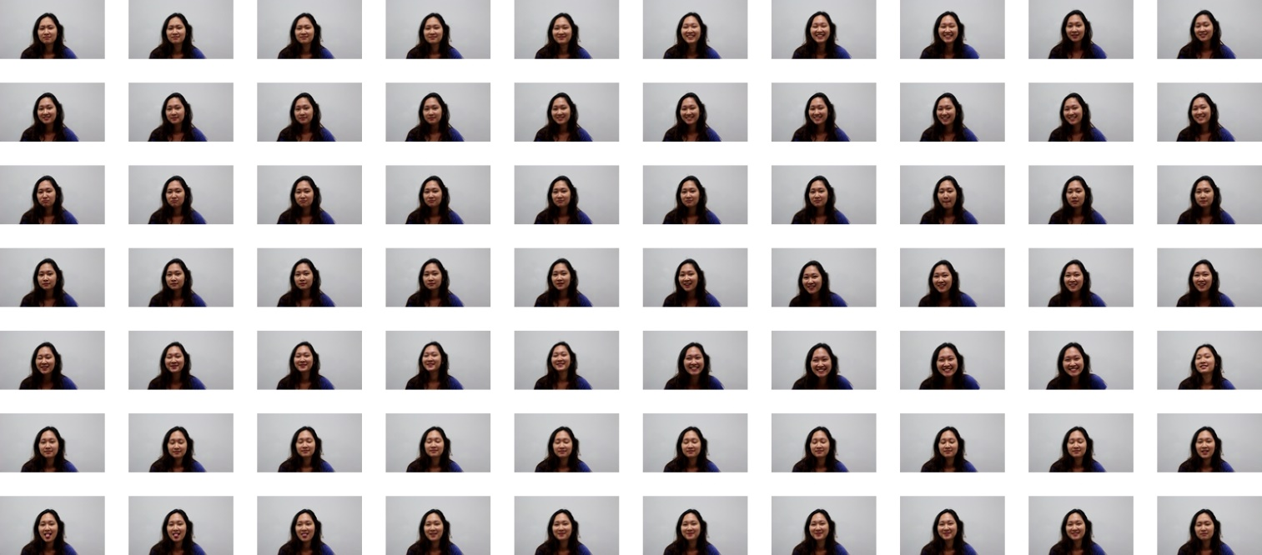
METHODOLOGY
Train Data Set
Data Set is composed of the faces of the students execute different facial expressions

Slide 6
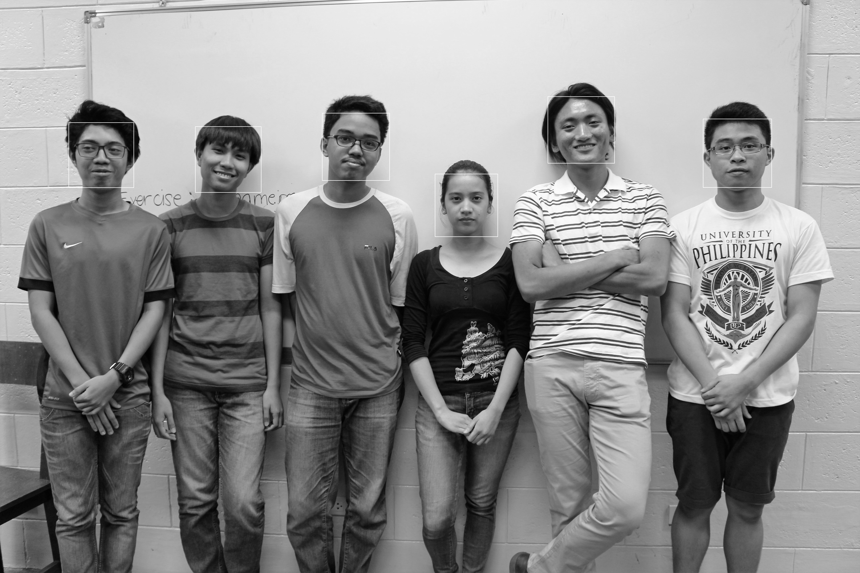
METHODOLOGY
Detect Faces
Given the attendance image of the day, the application will detect faces on the images.
Uses ‘frontal face’ haar-cascade

Slide 7
METHODOLOGY
Recognize Faces
Uses ‘Local Binary Patterns Histogram’ algorithm
For all the faces that are detected, the recognizer will give a prediction
Output of the recognizer:
Prediction Confidence Level (PCL)
Label of the predicted face
Threshold: [45-40]
If PCL < threshold, accept recognition, else reject recognition

Slide 8
METHODOLOGY
Save Recognized Faces
The recognized faces and data of the class will be saved in the database.

Slide 9

RESULTS and DISCUSSION

Slide 10
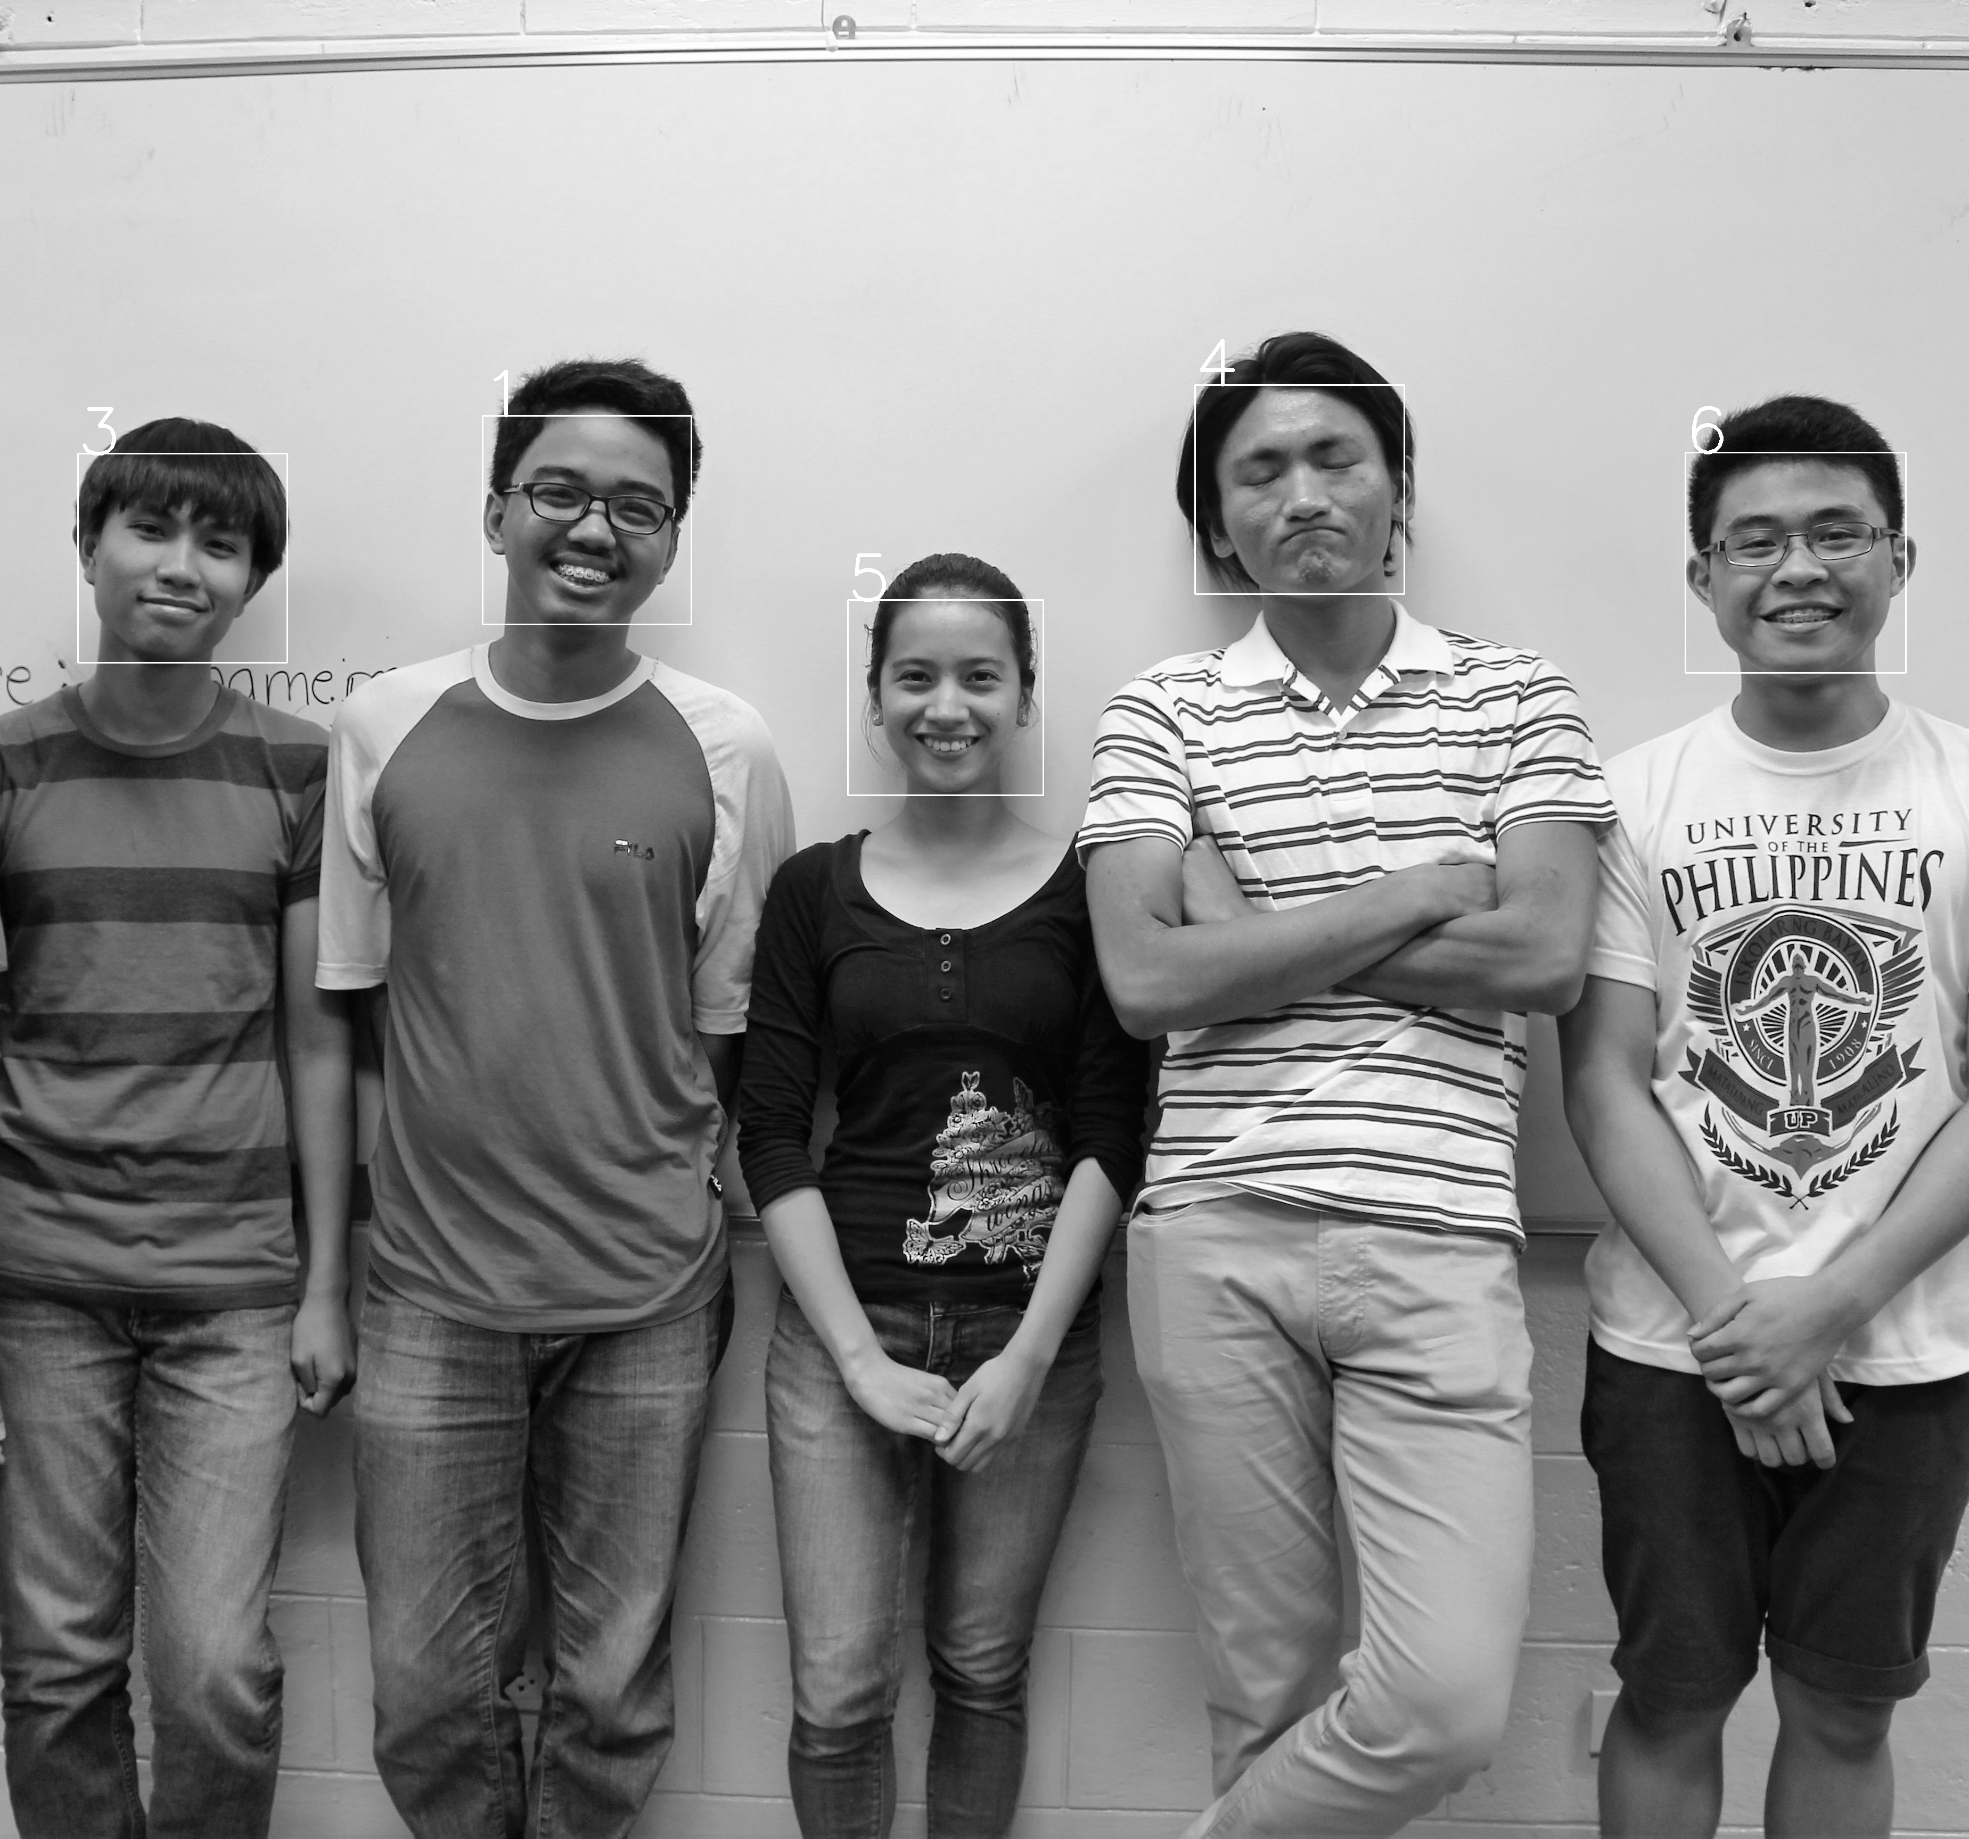
RESULTS and DISCUSSION

Slide 11
RESULTS and DISCUSSION
CONFIDENCE LEVEL OF PREDICTIONS
1st Image |  | 2nd Image
Student 1 | 75.2 | Student 1 | 71.86
Student 2 | 66.58 | Student 2 | ABSENT
Student 3 | 62.43 | Student 3 | 65.84
Student 4 | 67.34 | Student 4 | 65.35
Student 5 | 73.77 | Student 5 | 74.48
Student 6 | 71.48 | Student 6 | 69.41
AVERAGE | 69.47 | AVERAGE | 69.39
AVERAGE FOR GROUP 1: 69.43

Slide 12
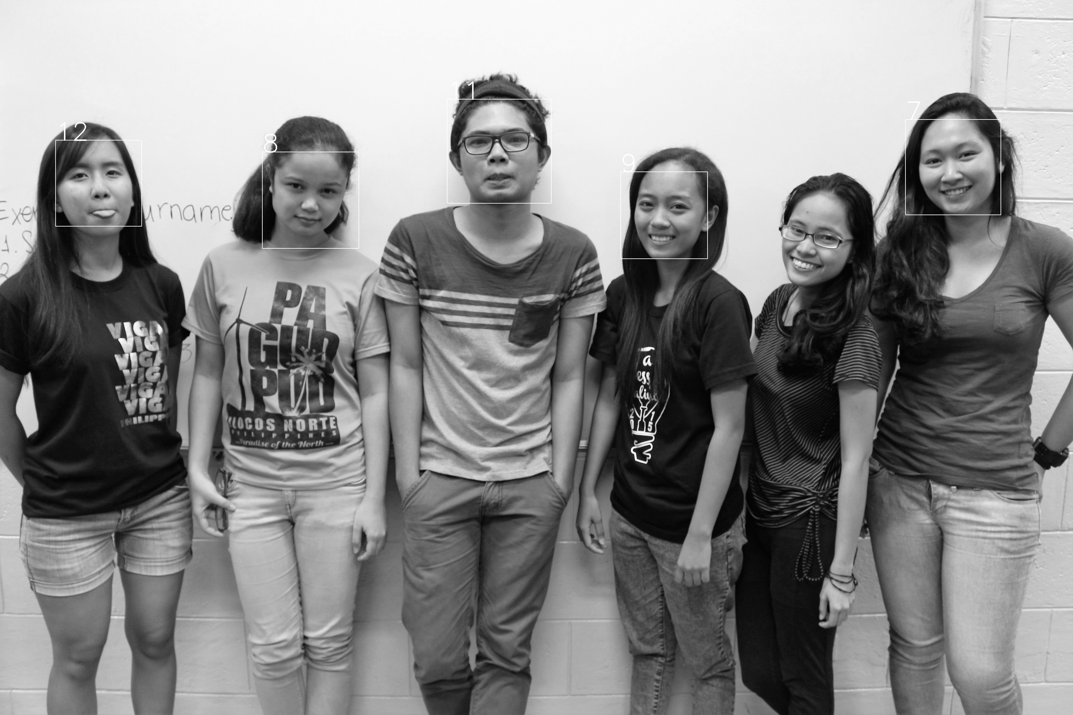
RESULTS and DISCUSSION

Slide 13

RESULTS and DISCUSSION

Slide 14
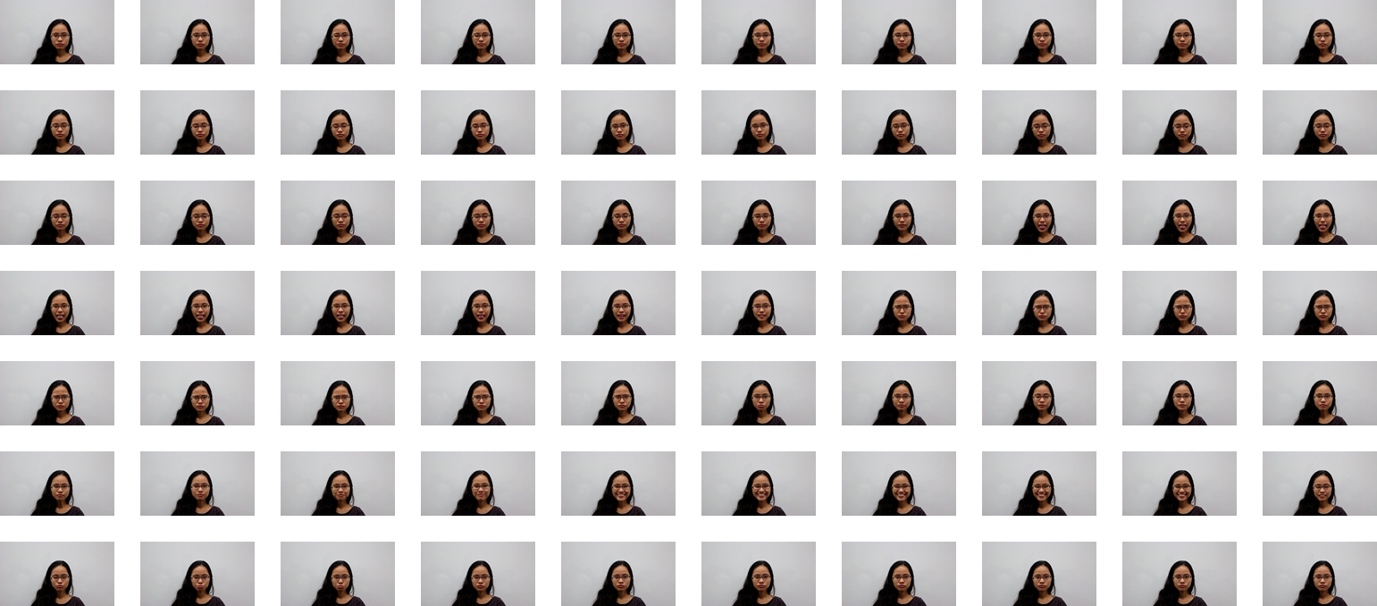
RESULTS and DISCUSSION

Slide 15
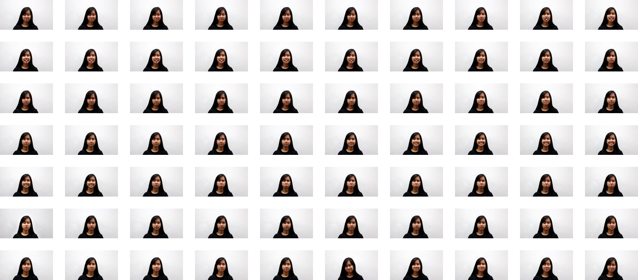
RESULTS and DISCUSSION

Slide 16
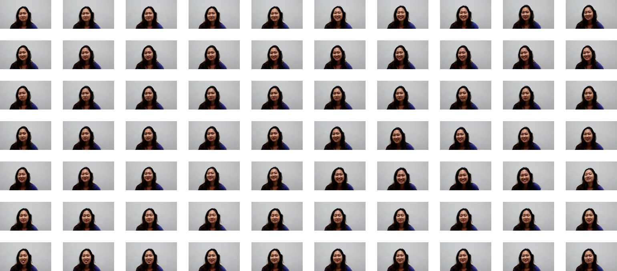
RESULTS and DISCUSSION

Slide 17
RESULTS and DISCUSSION
CONFIDENCE LEVEL OF PREDICTIONS
1st Image |  | 2nd Image
Student 1 | 62.76 | Student 1 | 60.92
Student 2 | 63.91 | Student 2 | 65.47
Student 3 | 58.43 | Student 3 | 62.5
Student 4 | 0 (NOT RECOGNIZED) | Student 4 | 0 (NOT RECOGNIZED)
Student 5 | 74.01 | Student 5 | 73.68
Student 6 | 69.72 | Student 6 | 0 (NOT RECOGNIZED)
AVERAGE | 54.81 | AVERAGE | 43.28
AVERAGE FOR GROUP 2: 49.28

Slide 18
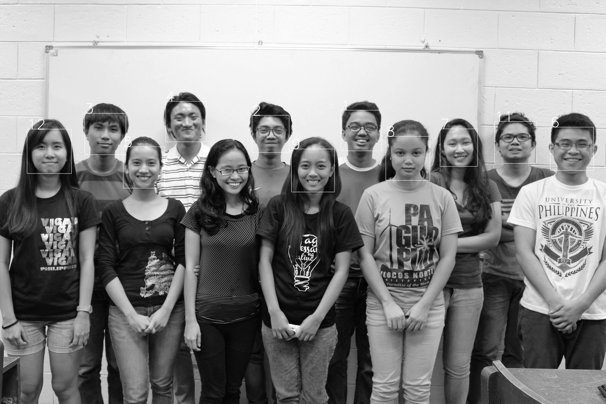
RESULTS and DISCUSSION

Slide 19
RESULTS and DISCUSSION
CONFIDENCE LEVEL OF PREDICTIONS
Student 1 | 68.77 | Student 7 | 73.4
Student 2 | 68.92 | Student 8 | 67.65
Student 3 | 67.05 | Student 9 | 70.4
Student 4 | 65.34 | Student 10 | 0
Student 5 | 67.71 | Student 11 | 64.58
Student 6 | 66.83 | Student 12 | 68.8
AVERAGE | 69.47 | AVERAGE | 69.39
AVERAGE FOR GROUP 3: 62.45

Slide 20
CONCLUSION
Based on the average confidence level of the predictions, the application has 60.13% accuracy for the given data
BUT the accuracy can vary and increase depending on the data set to be trained
The images in the training data set can affect the accuracy of the face recognition

